Slide 1
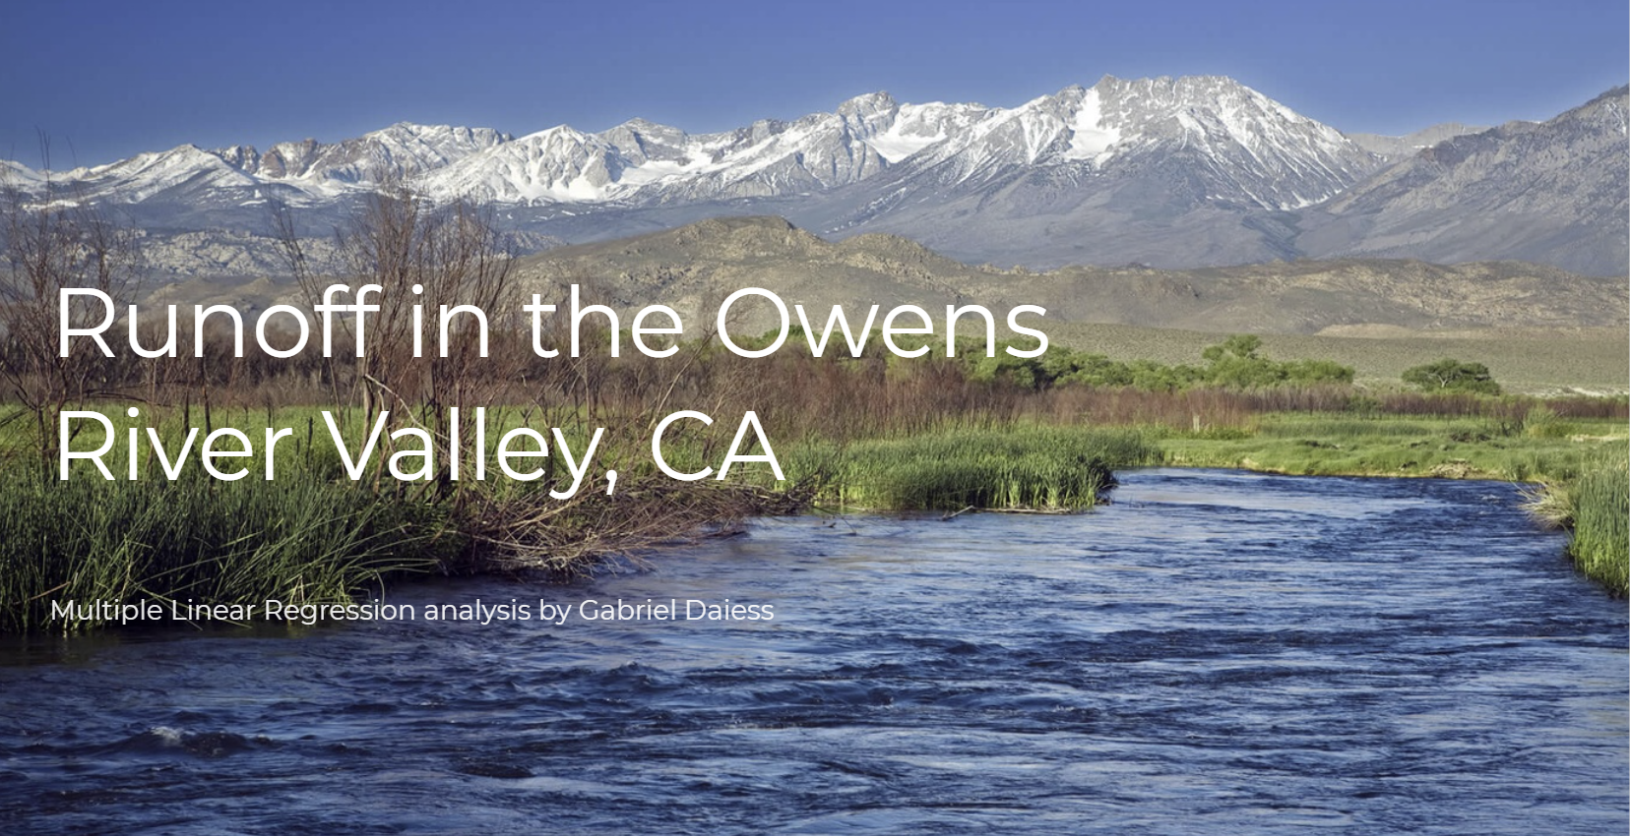
Notes:
Great job to everyone on their presentations thus far, looking forward to the upcoming ones
My name is Gabriel and today we’ll be talking about
Hopefully you find it interesting and get introduced to a newish topic

Slide 2

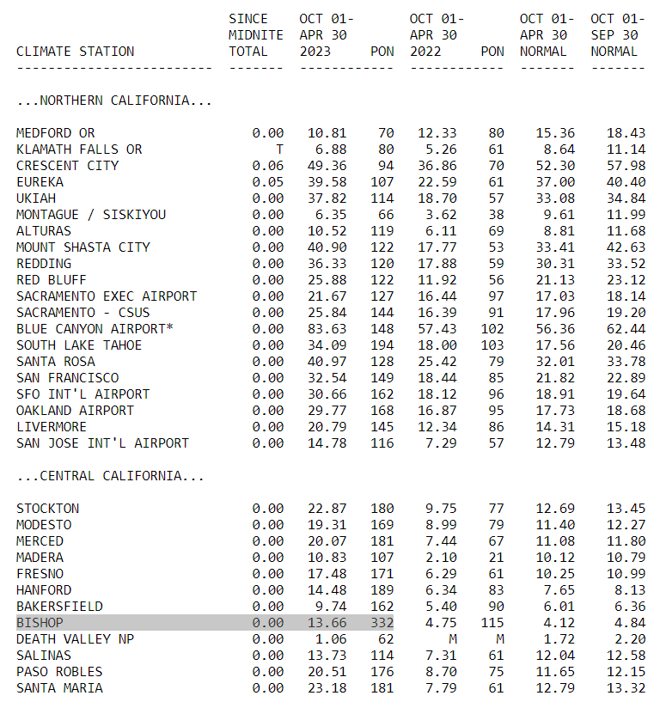
Notes:
Before jumping into the analysis I wanted to quickly talk about my own personal and academic motivations to look at water data
I have worked in California water resources since 2015 mostly looking at data, which is what brought me to this program Here’s a pic of me on one of my favorite local watersheds this past September
It was also a very wet year, it was not just your imaginations 68% more than normal for the time period of oct - may of this year compared to last

Slide 3
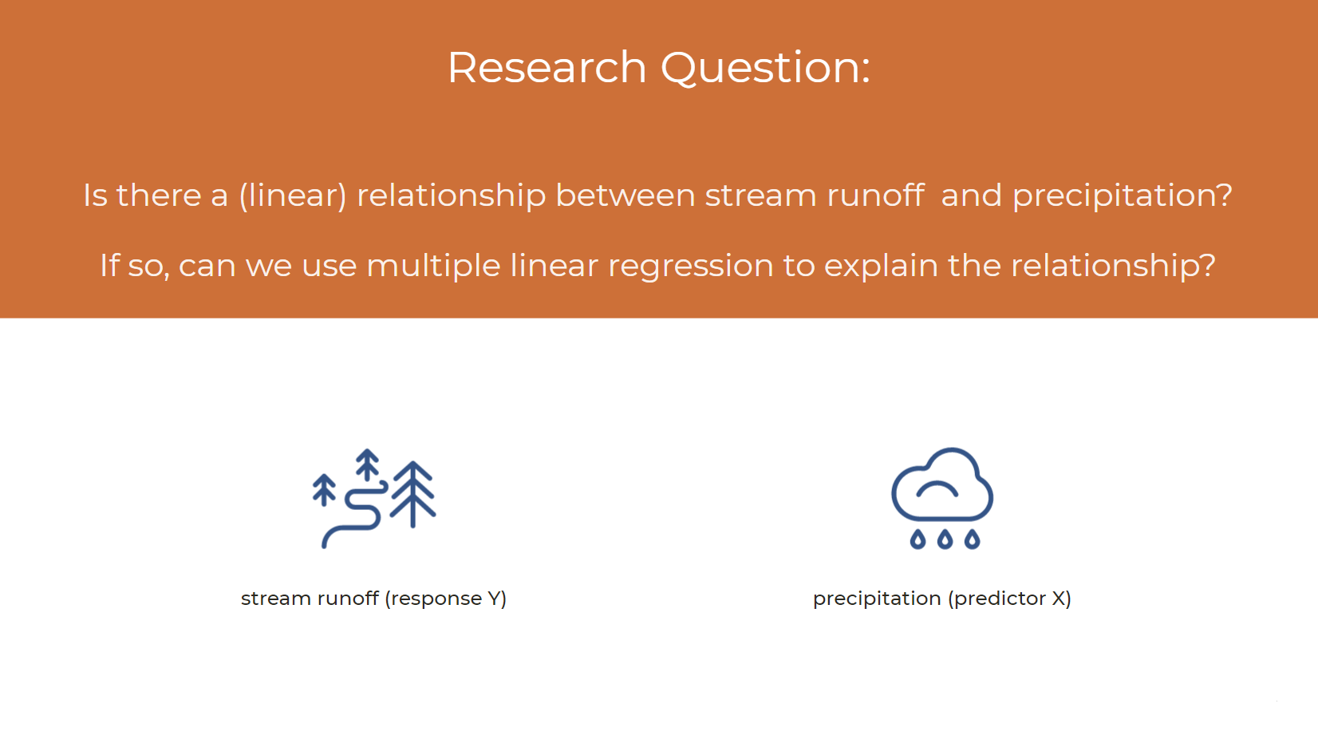
Notes:
Does the relationship exist, how strong is it?
To be clear stream runoff is the response and precipitation is the predictor

Slide 4
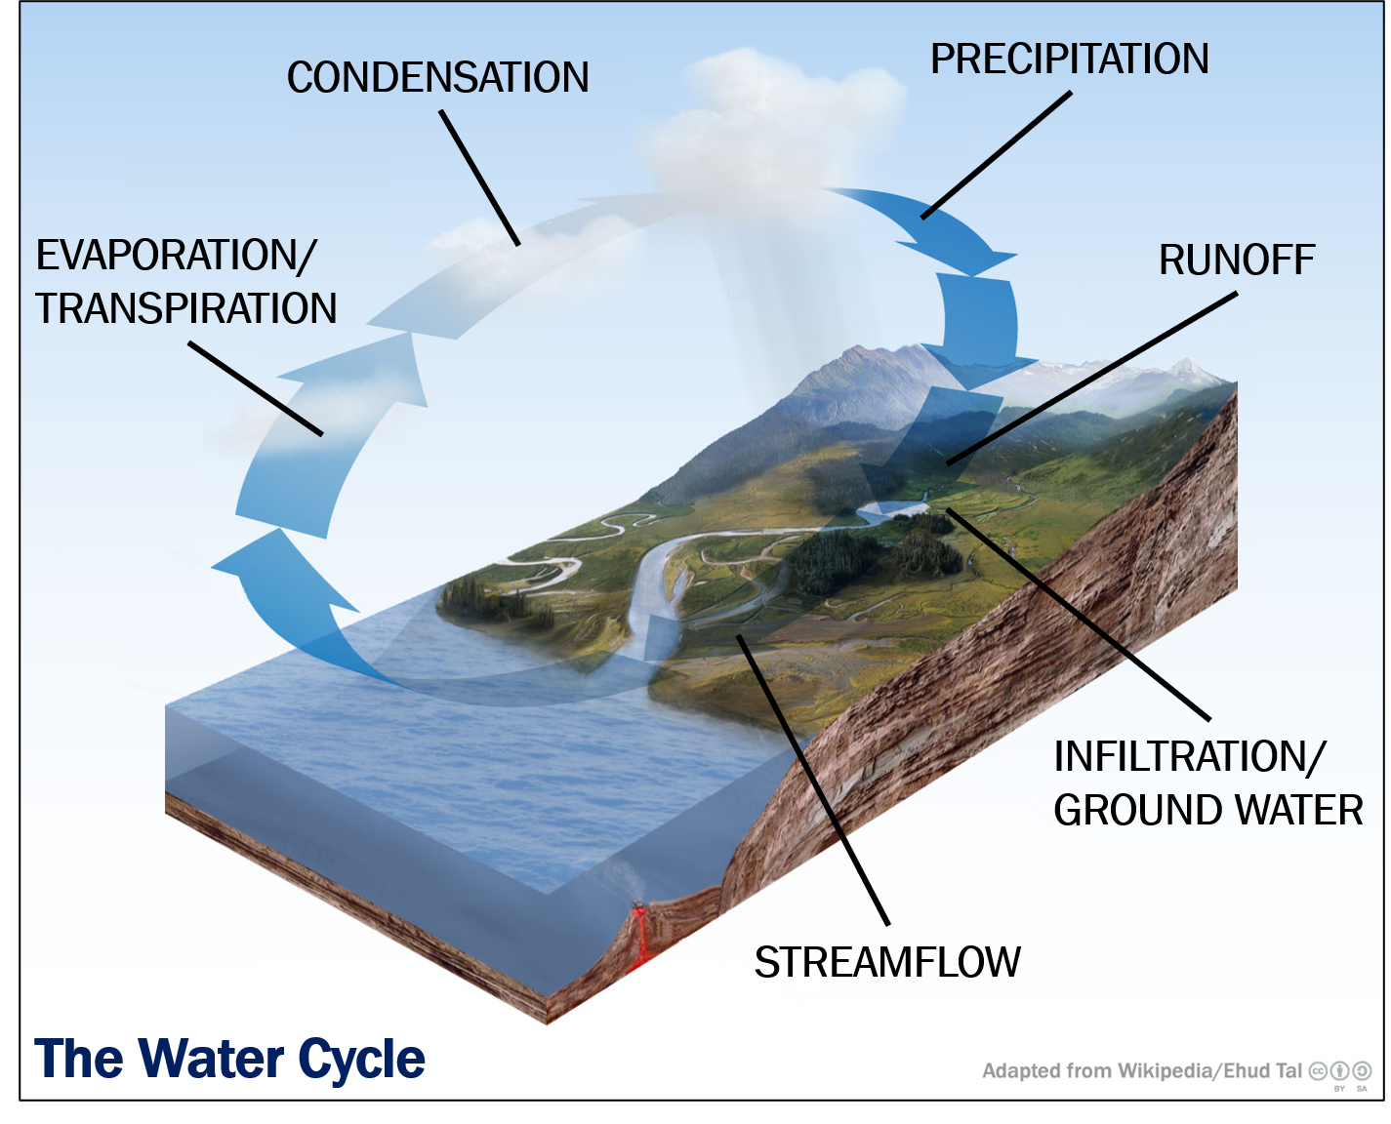
Notes:
We’ll be looking at precipitation (snow in this case)
And how it predicts runoff which is the snowmelt coming off the mountains
Runoff is very important to manage in CA water because we have dry summers as a result most rivers have dams eventually feed the streams

Slide 5
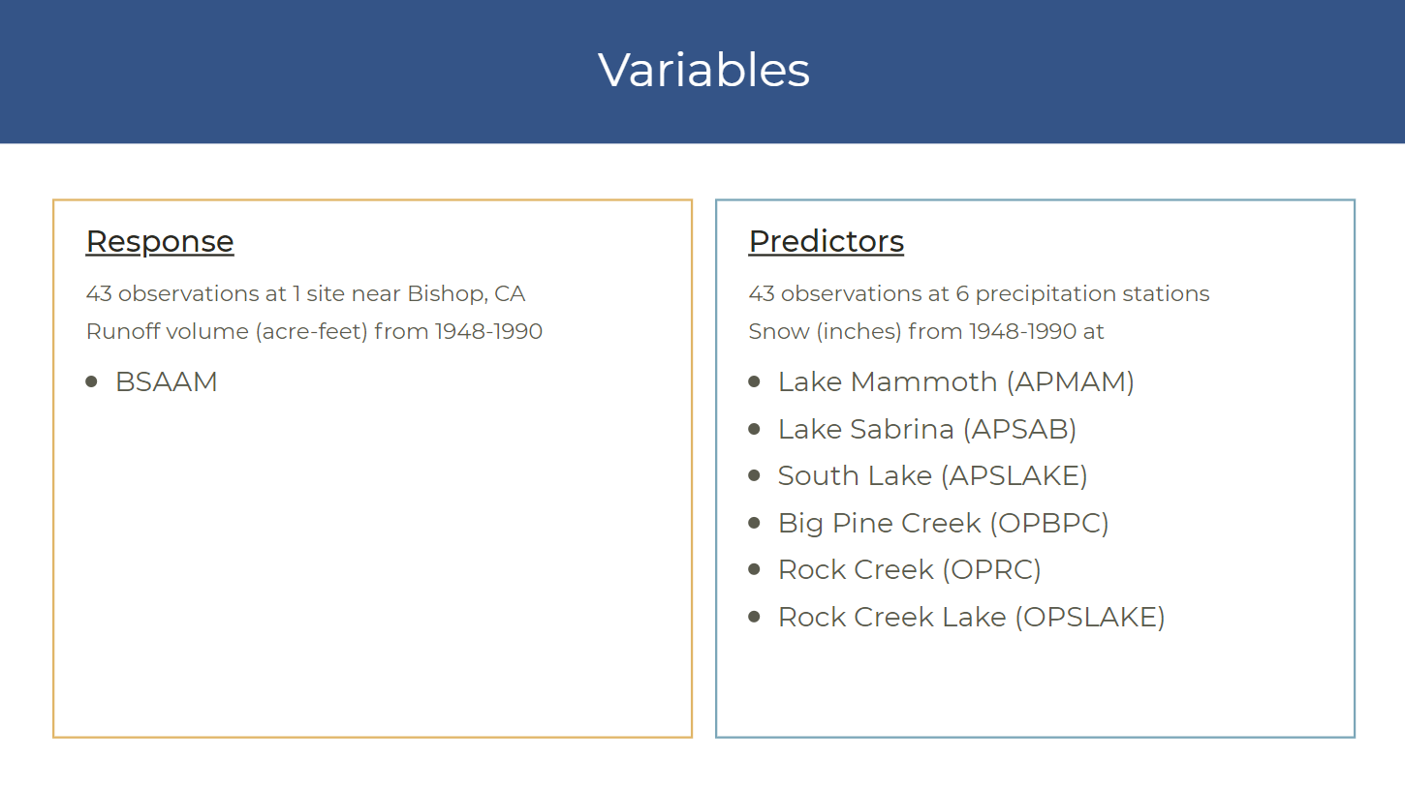
Notes:
After this talk about station locations on Google Earth

Slide 6
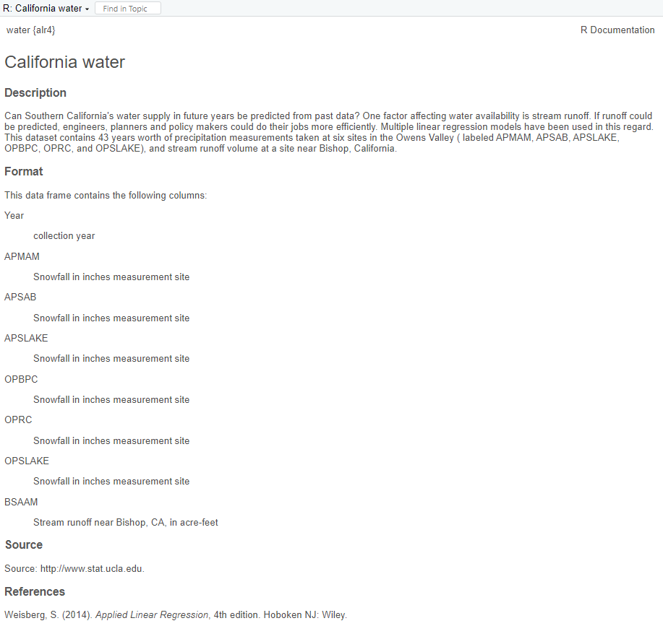

Data Source
> library(alr4)
> data(water)
Applied Linear Regression (4th ed.)
Sandy Weisberg

Slide 7
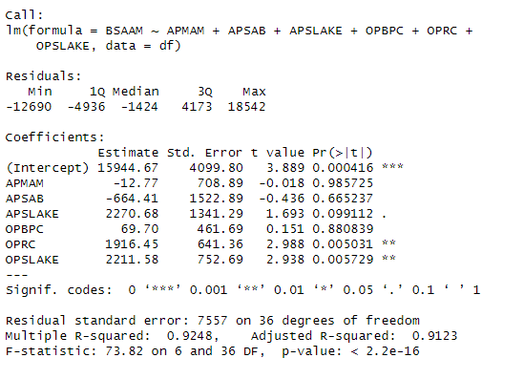
Model 1: Full Model all 6 Stations

Slide 8
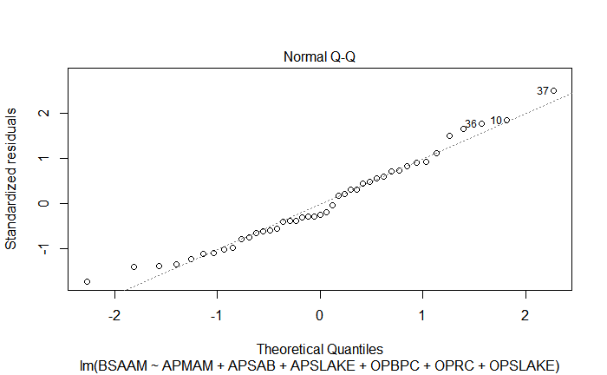
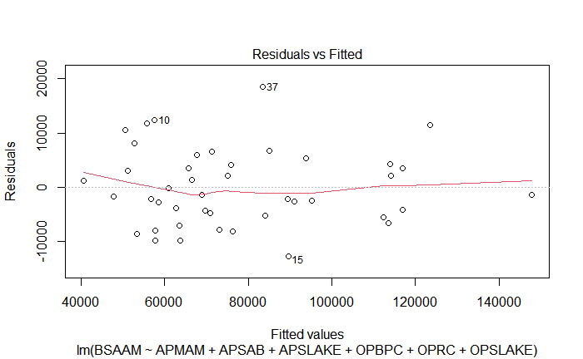
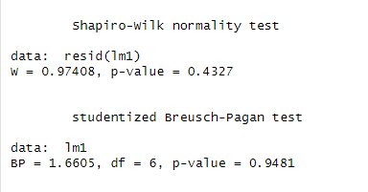
Model 1: Diagnostics Satisfied (!?)
Notes:
p-value of the Breusch-Pagan test is larger than alpha, it means that there is no evidence of heteroscedasticity in the model. This is generally a good thing, as it means that the assumption of homoscedasticity (constant variance) is reasonable

Slide 9
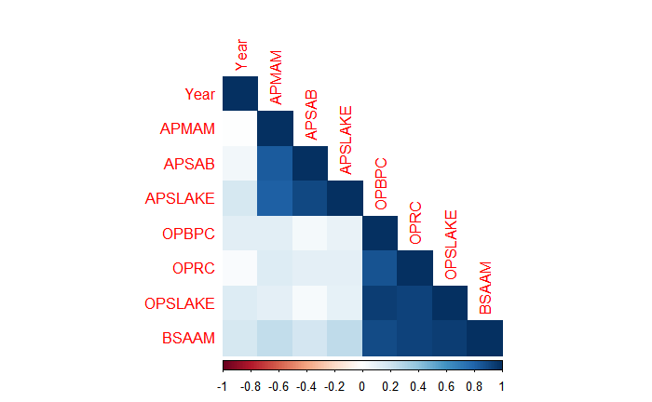
Multicollinearity
Only 2 of the 6 stations were significant in the initial model despite a very high R²
The signs of estimates at stations APMAM and APSAB were negative
MLR assumptions well-satisfied despite these issues
Notes:
Only 2 of the 6 predictor variables were significant IN THE PRESENCE OF ONE ANOTHER, OPRC Rock Creek and OPSLAKE South Lake
We see a clustering of correlation in that AP stations are correlated and OP stations as well

Slide 10
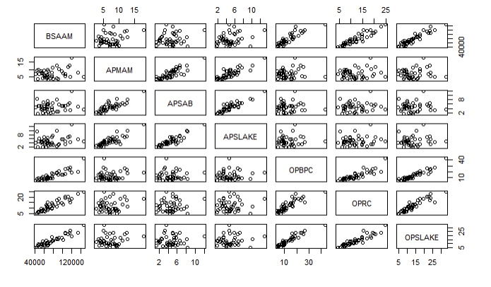
Multicollinearity
Station | VIF
APMAM | 3.55
APSAB | 7.18
APSLAKE | 6.75
OPBPC | 9.27
OPRC | 7.65
OPSLAKE | 16.97
Notes:
Scatterplot matrix shows the same almost linear relationship between each of the AP Stations as well as a similar trend among the OP stations
And we get Variable Inflation Factors for each (aside from APMAM) above 5

Slide 11


Slide 12
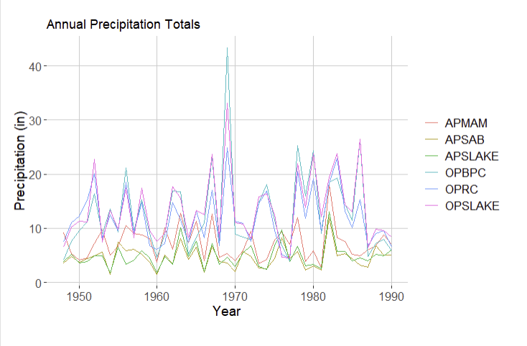
Time Series
Concerned with analyzing observations that are collected over intervals of time (regular or irregular intervals)
Useful for forecasting: predicting future values from previous data and their trends
Regression is used in Time Series: Y is the forecast variable and X is the predictor
Notes:
In this case the intervals are regularly spaced years
Forecasting is of great importance in environmental fields which is why I chose a time series dataset
Here is the trend of precip over time at each station, the curves follow one another, parallel lines

Slide 13
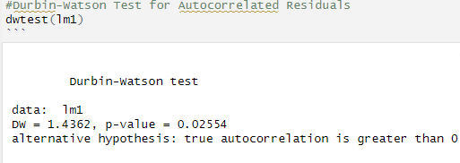
Autocorrelation
“Just as correlation measures the extent of a linear relationship between two variables, autocorrelation measures the linear relationship between lagged values of a time series.”
‌
(Hyndman, R. J., & Athanasopoulos, G. (2018). Forecasting : Principles and Practice (2nd ed.). Otexts. https://otexts.com/fpp2/)
Notes:
A observation vs itself in the past, can be on either the forecast variable or the predictor though more commonly the forecast variable. So say 1989 station APMAM data and 1990 APMAM data
If the autocorrelation is high, it can also indicate that the variable is not independent which violates assumptions of a regression model.
It is different from multicollinearity which as we know is a redundancy of data two predictors telling us something about one another
Autocorrelation is when data related to ITSELF as opposed to one predictor being related to another.
So there is a test we can do in R to assess the autocorrelation of the residuals of an lm object, called the Durbin-Watson test. I ran the test on my full model and concluded that the residuals are indeed autocorrelated.

Slide 14
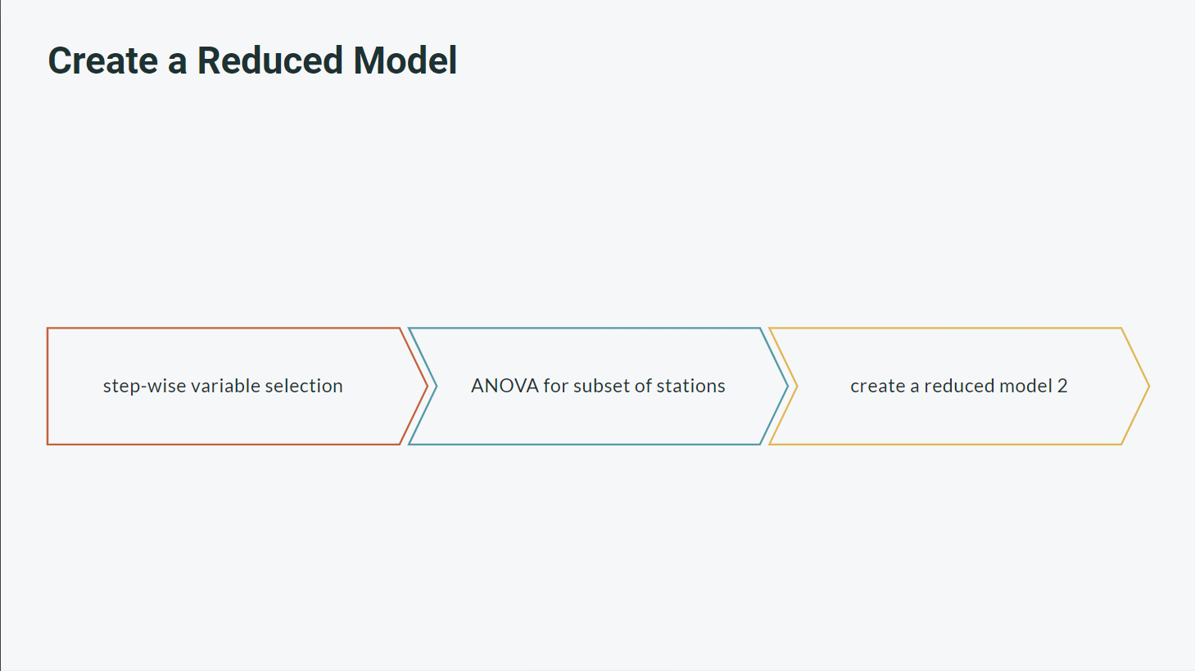
Notes:
Knowing that we have multicollinearity and autocorrelation we do what any good stats 632 student would
Stepwise selection of variables, get the lowest AIC
Out of an abundance of caution run an ANOVA to see if all subsets can be dropped at once

Slide 15
Notes:
The values are large because the acre-feet of runoff estimated is usually large
3 stations left

Slide 16
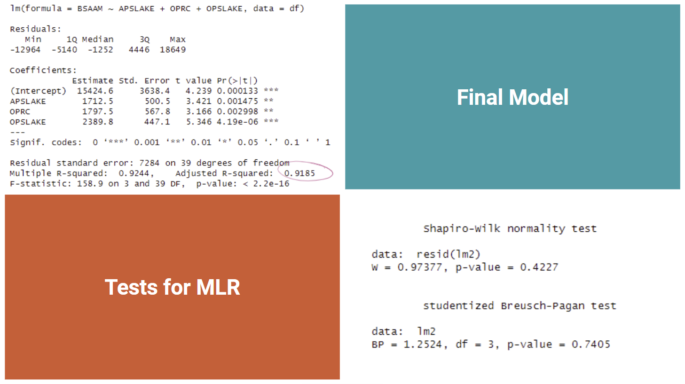

Slide 17
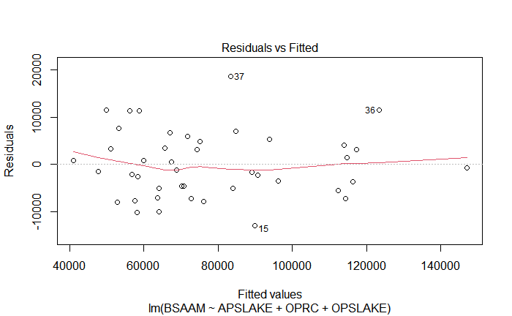
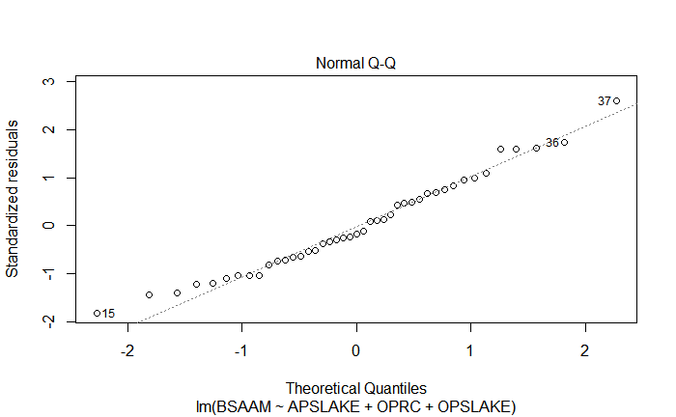

Slide 18
Limitations and Further Research
Cookbook/Data background very limited
BSAAM response not well defined geographically or in terms of hydrology
Reproducibility for Future Studies
Station names were not given full names for the dataset, which makes it hard to
update the dataset and continue with forecasting.
validate the model against “real-life” data
Textbook Example
Meant to be open to interpretation, more than ONE right answer (log transformation could work too)
Simplified without too many observations (more stations could be added)
In the future I look forward to doing a similar analysis of time series data to forecast hydrologic phenomenon in CA

Slide 19


